Slide 1
Valuation of Intangible Assets

Slide 2
Learning Outcome
Identify the Intangible Assets covered under the scope of Ind AS 38
Illustrate the recognition procedure of Intangible Assets as per Ind AS 38.
Appraise disclosure requirements and transitional provisions related to measurement of Intangible Assets under Ind AS 38.
Compare the provisions of AS 26 and Ind AS 38.

Slide 3
Intangible Assets as per Ind AS 38
It is an identifiable non-monetary asset without physical substance
Based upon above meaning, the main three features of intangible assets are:
Identifiable
Non-monetary asset
Without physical substance

Slide 4
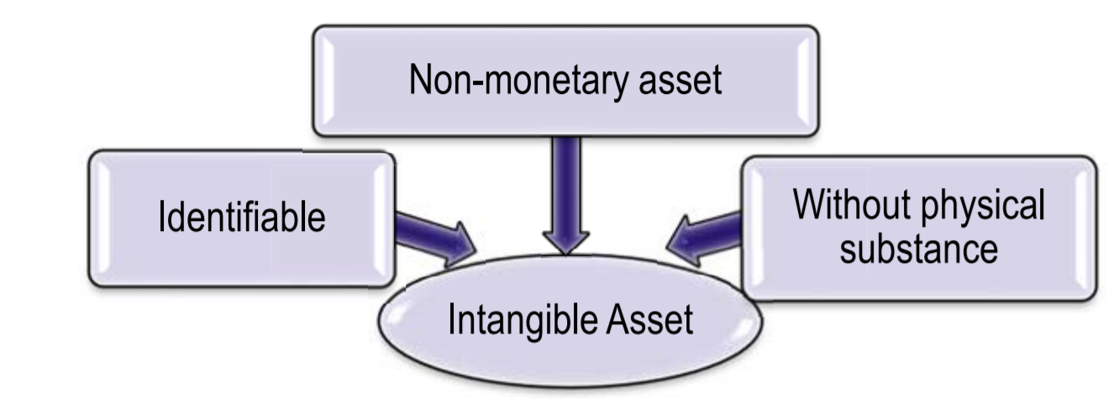
Intangible Assets

Slide 5
Features of Intangible assets
1. Identifiable
An asset is identifiable if it satisfies either of the following conditions:
(a) is separable, i.e., is capable of being separated or divided from the entity and sold, transferred, licensed, rented or exchanged, either individually or together with a related contract, identifiable asset or liability, regardless of whether the entity intends to do so;
or
(b) arises from contractual or other legal rights, regardless of whether those rights are transferable or separable from the entity or from other rights and obligations.

Slide 6
Cont..
2. Non-Monetary Assets
If the value to be received against the assets is not fixed by contract.
3. No Physical Substance
if the cost/value of physical substance is more then assets should be treated as fixed asset.

Slide 7
Activity
Classify the following assets as Monetary or Non-Monetary assets
Debtors
Building
Patent
Receivables
Trademark

Slide 8
Solution
Debtors---Monetary
Building—Non-Monetary
Patent-- Non-Monetary
Receivables-- Monetary
Trademark---Non-Monetary
Rationale: As the amount to be received for debtors and receivables is fixed and does not vary. But vice-versa is other assets as given above.

Slide 9
Poll
A company has purchased one accounting software and the provider of the same supplied the software through compact disk. Is computer software tangible or intangible asset?
Yes
No
State reasons as it does have physical substance in form of Compact disk.

Slide 10
Solution
Yes, computer software is intangible assets as:
Cost of physical substance (CD) is insignificant as compared to intangible (Software)

Slide 11
Activity
Classify each of the following assets as either tangible or intangible
A) The operating system of a personal computer
B) An off-the-shell integrated publishing software package
C) Specialized software embedded in computer controlled machine tools.
D) A “firewall” controlling access to restricted section of an internet website.

Slide 12
Solution
Tangible: The operating system (eg. DOS or Windows) of a personal computer is integral part of the related hardware and should be accounted for under AS-10 Fixed assets.
Intangible: Such component software (eg. QuarkXPress) is not an integral part of the hardware on which it is used.
Tangible: Specialized software integrated into production line “robots” is similar to (A)
Intangible: Companies developing “firewall: software to protect their own website may also sell the technology to other companies.

Slide 13
Summary for recognition
For an item to be recognised as an intangible asset it must meet the definition of an intangible asset i.e.,
identifiability,
control over a resource and
existence of future economic benefits
Notes:
An entity controls an asset if the entity has the power to obtain the future economic benefits flowing from the underlying resource and to restrict the access of others to those benefits. The capacity of an entity to control the future economic benefits from an intangible asset would normally stem from legal rights that are enforceable in a Court of law. In the absence of legal rights, it is more difficult to demonstrate control.

Slide 14
Common Examples of Intangible assets
Goodwill
Advertising expenses
Training
Startup Cost
R&D activities
Rights under License agreements such as Motion picture films, manuscripts etc.
Patents and Copyrights, Trademarks, Brand
Computer Software
Any other meeting the definition of Intangible assets as per Ind AS 38

Slide 15
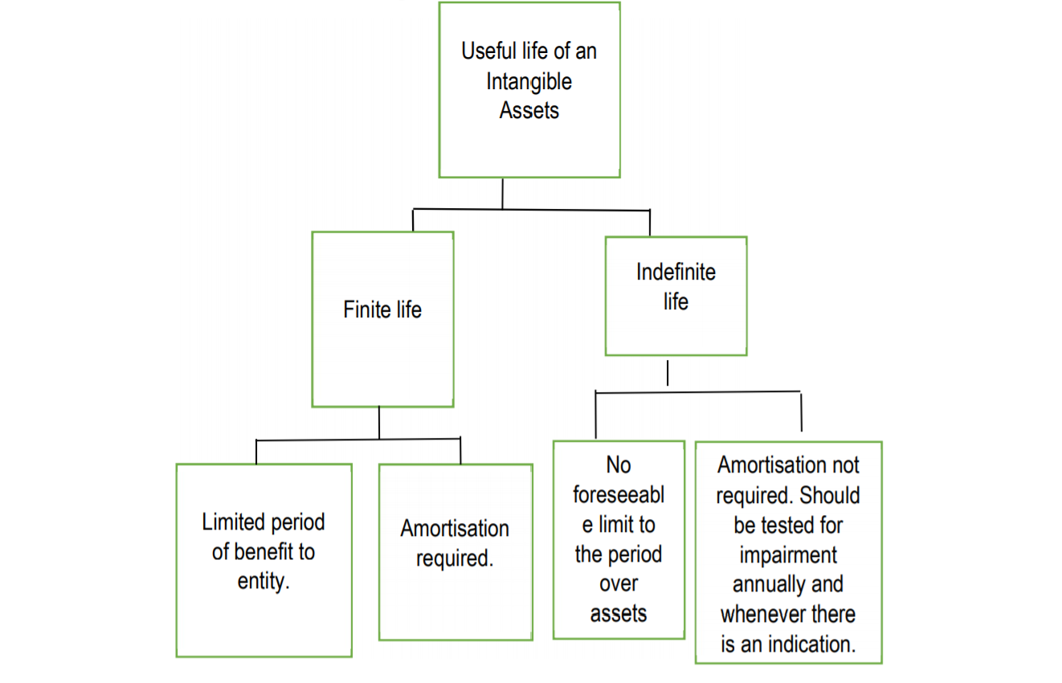
Notes:
An intangible asset can be considered indefinite (a brand name, for example) or definite, like a legal agreement or contract.

Slide 16
Disclosure Requirements
The financial statements should disclose the following for each class of intangible assets, distinguishing between internally generated intangible assets and other intangible assets:
Whether useful lives are definite or indefinite
Useful lives or amortization rate and method used
Gross carrying amount and accumulated amortization at the beginning and at the end of the period
Reconciliation of carrying amount at the beginning and at the end of the period
Amount of R & D expensed out

Slide 17
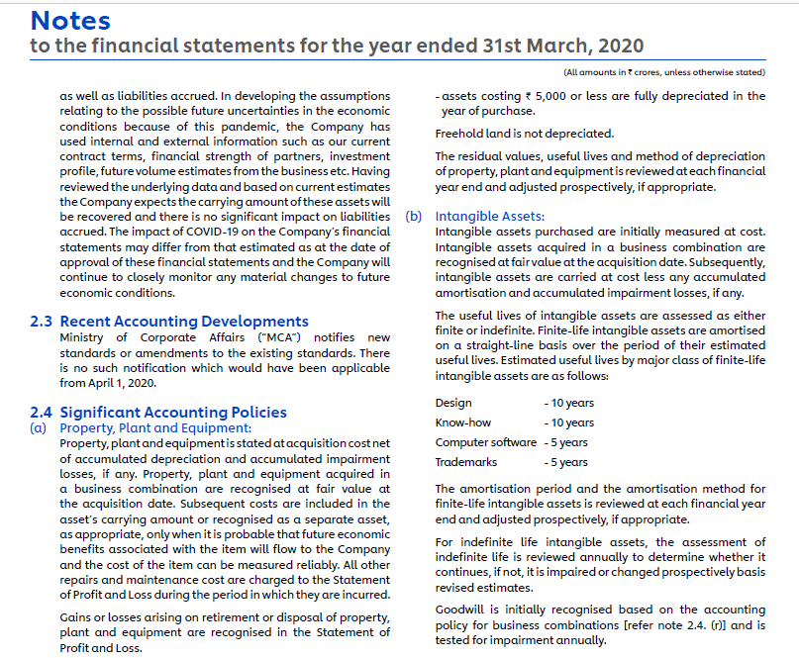
Annexure from HUL Annual Report 2019-2020
Disclosures of Intangible Assets: HUL

Slide 18
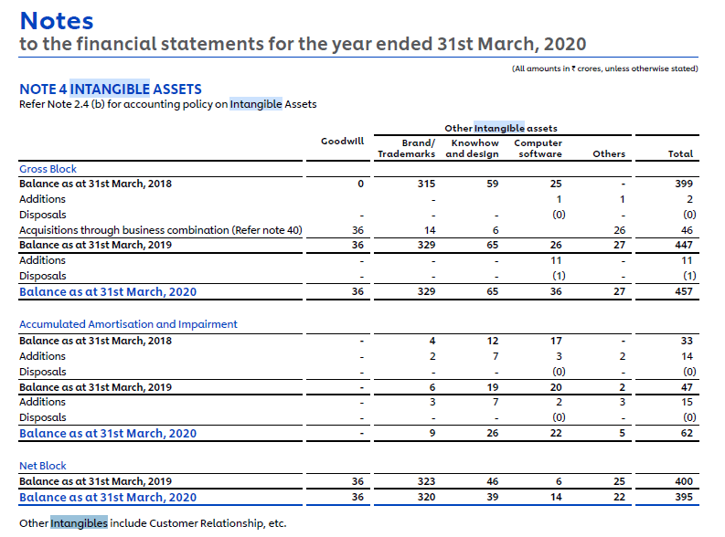
Cont..

Slide 19
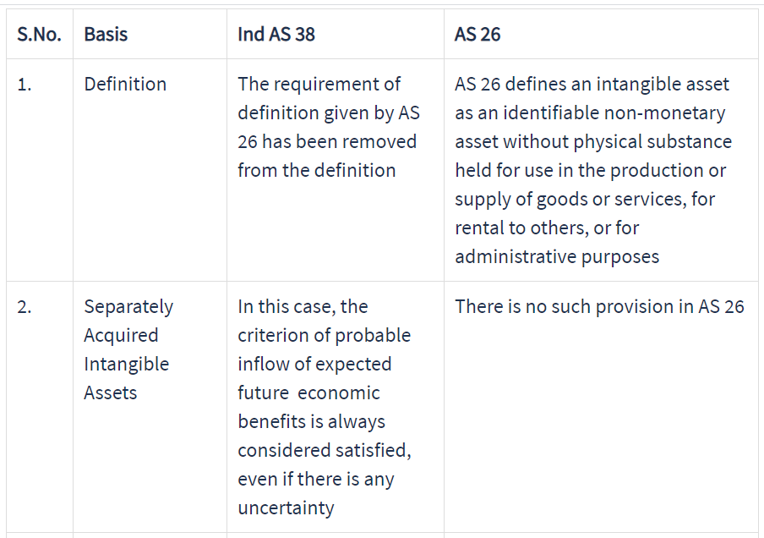
Comparison of AS 26 and Ind AS 38

Slide 20
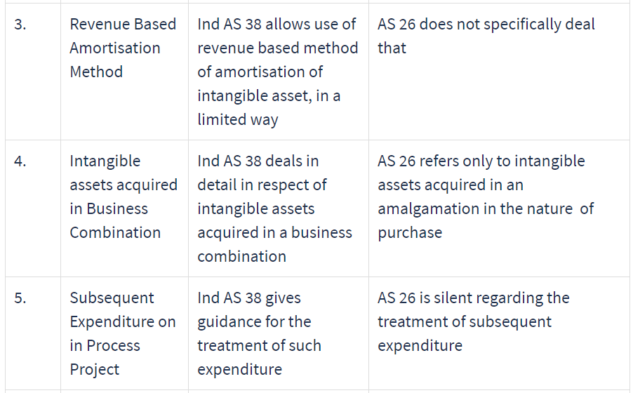

Slide 21
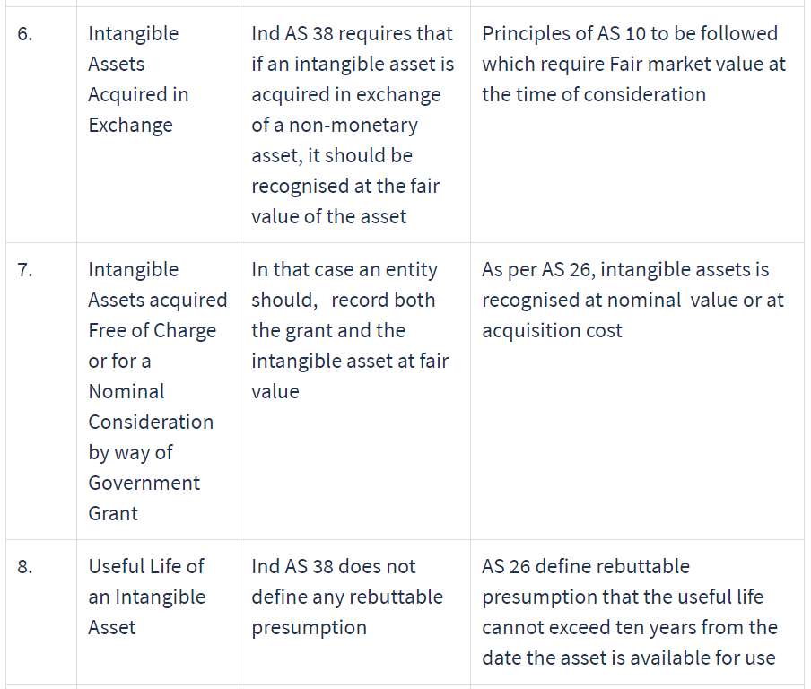

Slide 22
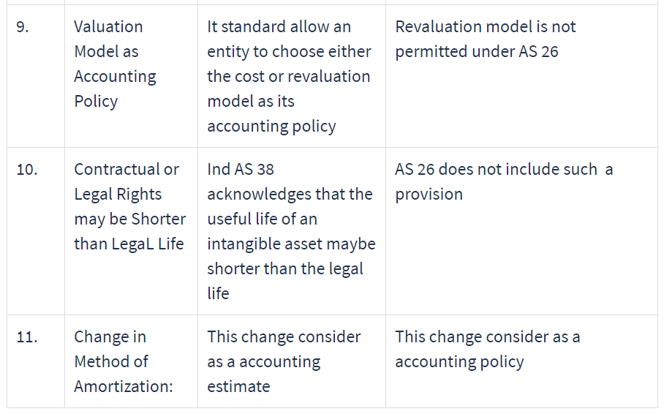
Notes:
https://aglatax.com/accounting/as-26-vs-ind-as-38.html
https://cleartax.in/s/as-26-intangible-assets#comparison

Slide 23
What assets are Not covered by IND-AS 38?
Intangible assets held for sale in ordinary course of business(IND AS 2)
Deferred tax assets – covered by IND-AS 12,
Goodwill arising in a business acquisition– covered by IND-AS 103
Leases(IND-AS 17)
assets arising form employee benefits(IND-AS 19
Intangible assets held for sale – covered by IND-As 105Non-Current intangible Assets classified as Held For Sale,
Financial assets – covered by IND-AS 32 Financial Instruments: Presentation
Exploration and evaluation assets – covered by IND-AS 106 Exploration for and Evaluation of Mineral Assets,
Expenditures for development and extraction of minerals, oils, natural gas and other non-regenerative resources, etc.

Slide 24

CONFUSED!
ANY QUESTIONS?

